Slide 1
Direct Marketing campaigns of a Portuguese banking institution
By:
Ravishankar ramakrishnan

Slide 2
Project Scope
The data is related with direct marketing campaigns of a Portuguese banking institution. The marketing campaigns were based on phone calls. Often, more than one contact to the same client was required, in order to access if the product (bank term deposit) would be ('yes') or not ('no') subscribed.
The classification goal is to predict if the client will subscribe (yes/no) a term deposit (variable y).
Let us work on the Solution

Slide 3
Attribute Information:
1 - age (numeric)
2 - job : type of job (categorical: 'admin.','blue-collar','entrepreneur','housemaid','management','retired','self-employed','services','student','technician','unemployed','unknown')
3 - marital : marital status (categorical: 'divorced','married','single','unknown'; note: 'divorced' means divorced or widowed)
4 - education (categorical: 'basic.4y','basic.6y','basic.9y','high.school','illiterate','professional.course','university.degree','unknown')
5 - default: has credit in default? (categorical: 'no','yes','unknown')
6 - housing: has housing loan? (categorical: 'no','yes','unknown')
7 - loan: has personal loan? (categorical: 'no','yes','unknown')
# related with the last contact of the current campaign:
8 - contact: contact communication type (categorical: 'cellular','telephone')
9 - month: last contact month of year (categorical: 'jan', 'feb', 'mar', ..., 'nov', 'dec')
10 - day_of_week: last contact day of the week (categorical: 'mon','tue','wed','thu','fri')
11 - duration: last contact duration, in seconds (numeric). Important note: this attribute highly affects the output target (e.g., if duration=0 then y='no'). Yet, the duration is not known before a call is performed. Also, after the end of the call y is obviously known. Thus, this input should only be included for benchmark purposes and should be discarded if the intention is to have a realistic predictive model.

Slide 4
Attribute Information:
# other attributes:
12 - campaign: number of contacts performed during this campaign and for this client (numeric, includes last contact)
13 - pdays: number of days that passed by after the client was last contacted from a previous campaign (numeric; 999 means client was not previously contacted)
14 - previous: number of contacts performed before this campaign and for this client (numeric)
15 - poutcome: outcome of the previous marketing campaign (categorical: 'failure','nonexistent','success')
# social and economic context attributes
16 - emp.var.rate: employment variation rate - quarterly indicator (numeric)
17 - cons.price.idx: consumer price index - monthly indicator (numeric)
18 - cons.conf.idx: consumer confidence index - monthly indicator (numeric)
19 - euribor3m: euribor 3 month rate - daily indicator (numeric)
20 - nr.employed: number of employees - quarterly indicator (numeric)
Output variable (desired target):
21 - y - has the client subscribed a term deposit? (binary: 'yes','no')

Slide 5
Problem Python Notebooks
Extensive Python Notebook with All Algorithms, Working and Data Points, which can be used as a Template for Further Projects. Algorithms and ML Strategies Used were K Fold Cross Validation, Grid Search CV, SVC, K Neighbors Classifier, Decision Tree Classifier, Logistic Regression, Random Forest, Perceptron, Stochastic Gradient Descent Classifier, Linear Support Vector Classifier, Gaussian Naïve Bayes
Python Notebook with just a Subset of Data for Processing and Making Predictions using Neural Networks, Logistic Regression and SVM

Slide 6
Goal of Classification
The Goal of Performing this Classification is to predict whether a Client will subscribe to term deposit or not, based on Attributes of the Client

Slide 7
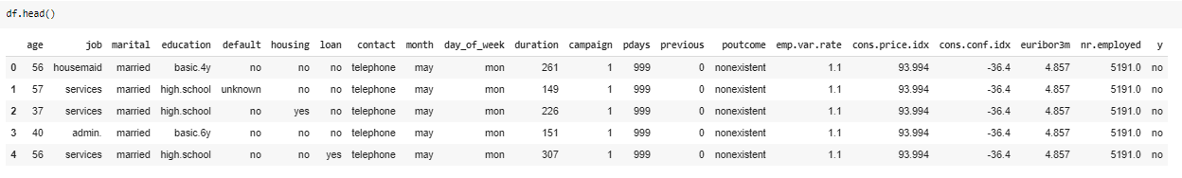
1. Introduction
The Dataset Consisted of 41,188 rows (Observation) and 21 columns (Attributes). The Sample of the
Dataset is Shown below:

Slide 8
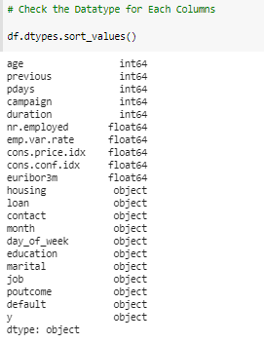
Data Types
By the Image Seen on the Left, The Age, Previous, Pdays, Campaign and Duration are Integers (Numerical)., nr.employed, emp.var.rate, cons.price.idx, cons.conf.idx, euribor3m are Float Variables (Numerical)., and the Remaining are having Object as data type (Categorical)

Slide 9
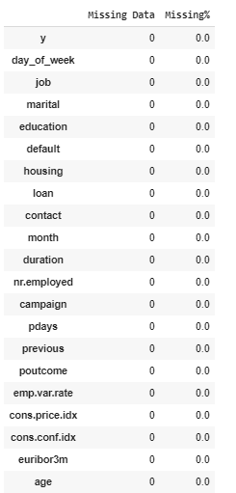
Missing Values Check:
We have Identified that there are No Missing Values present in all the Columns in the Dataset.
With this, we go with an Assumption that we have full data and Start the Data Preprocessing Process

Slide 10
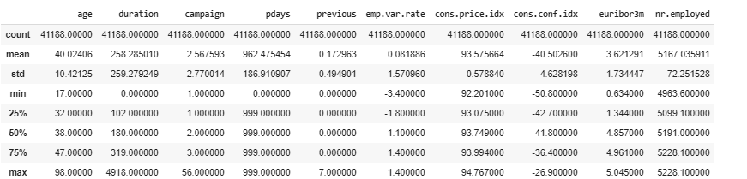
Descriptive Statistics
We Now Look for Descriptive Statistics to Identify the Distribution, Statistical Operations of the Dataset
From just seeing the Descriptive Statistics, we can Identify that Outliers are present. Eg: Age, Duration, cons.conf.idx

Slide 11
Outlier Detection
In statistics, an outlier is a data point that differs significantly from other observations. An outlier may be due to variability in the measurement or it may indicate experimental error; the latter are sometimes excluded from the data set. An outlier can cause serious problems in statistical analyses.
In Outlier Handling, Mean is Prone to Outliers, So we primarily use Median to Identify Outliers.
Outliers can also be Identified by Inter Quartile Range (IQR)
Outliers here are defined as observations that fall below Q1 − 1.5 IQR or above Q3 + 1.5 IQR.
Q1 is the median (the middle) of the lower half of the data, and Q3 is the median (the middle) of the upper half of the data.

Slide 12
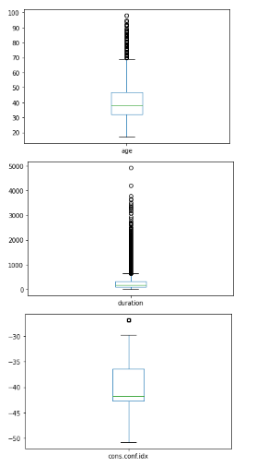
Outlier Detection
In the Right is the Boxplot, of “Age, duration and cons.conf.id”
The Lines in Box plot depicts
Min, Q1, median, Q3, Max.
The Bubbles outside the Line is the Outlier Data Points

Slide 13
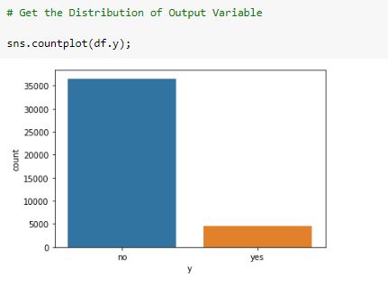
The Data distribution of the output is the must to identify whether the model can perform better or not.
We can see with Our Target Variable (y)
Distribution that It has Class Imbalance &
is an Imbalanced Dataset.
We can perform Operations (Data
Preprocessing) – Resampling such as SMOTE,
Synthetic Sample Generation, Under and
Over Sampling, Class Re weightage etc.

Slide 14
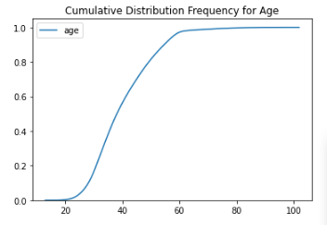
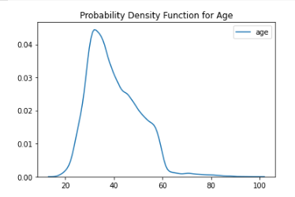
With cdf and pdf, we can identify the distribution of age.
Eg:
> with cdf, we can find 50% of population has age group below 40yrs.
> With pdf we see ages 25 – 48 is consisting of a larger population

Slide 15
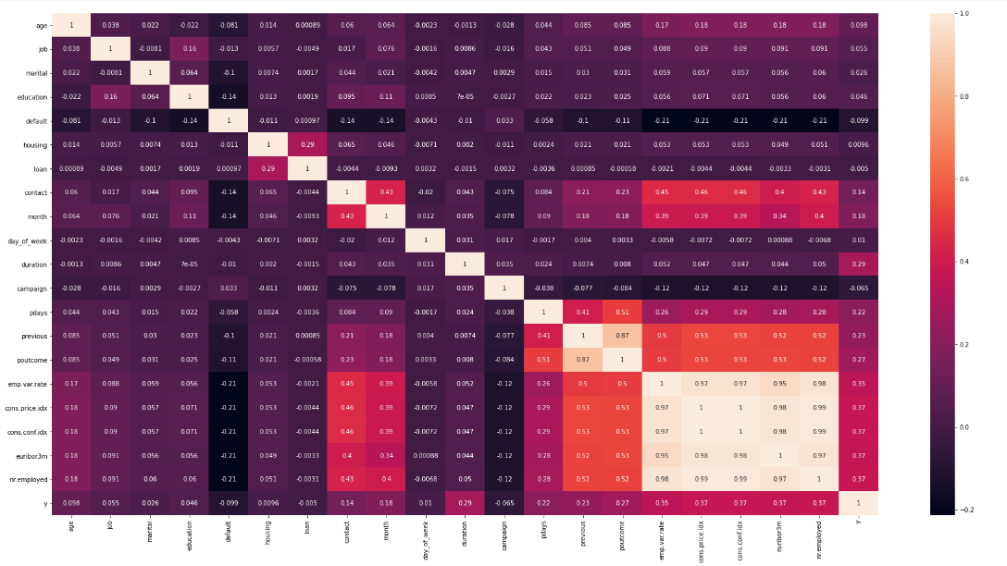
Pearson’s Correlation Coefficient of the Dataset

Slide 16
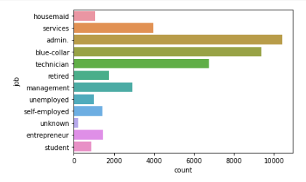
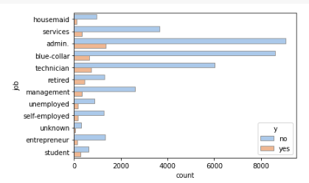
Job Distribution of Dataset
The Distribution of the Job Category in the Dataset is given by
The Job Category for which the Deposit is given is

Slide 17
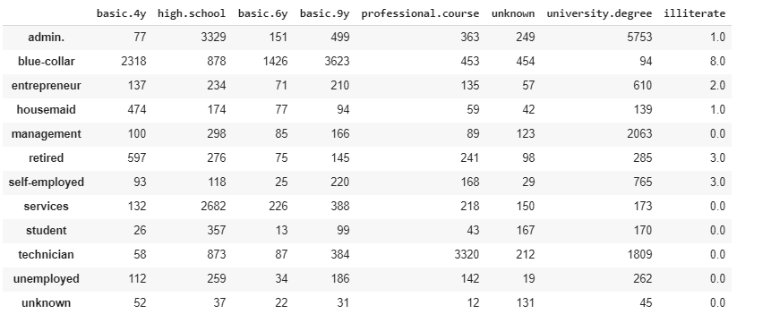
Crosstab Between Job vs Education

Slide 18
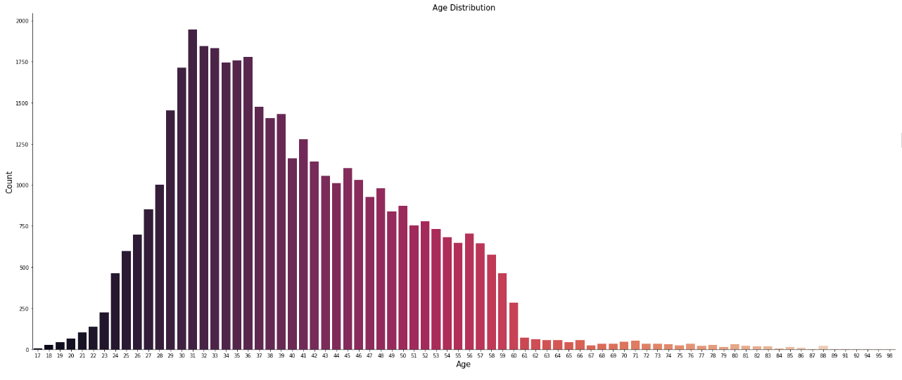
Age Distribution

Slide 19
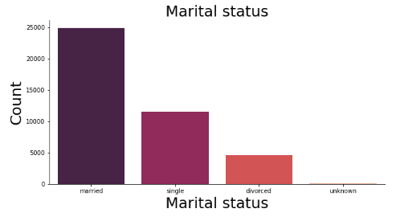
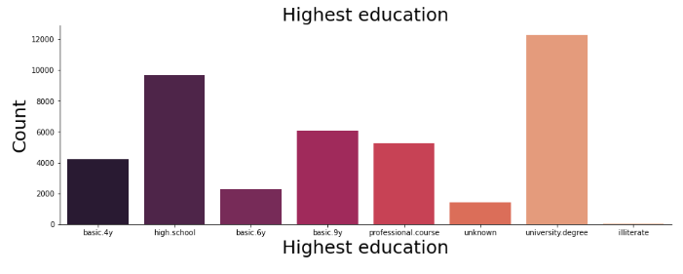
Plots of Marital Status and Highest Education

Slide 20
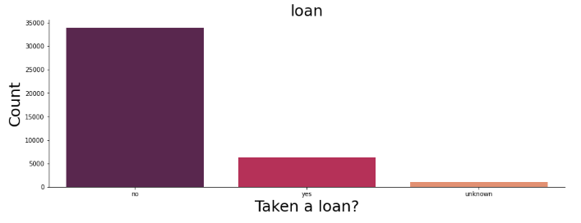
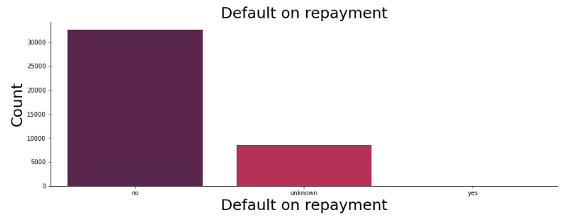
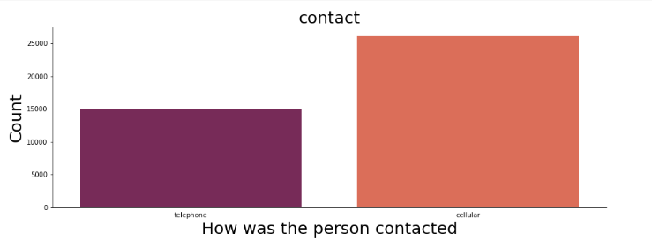
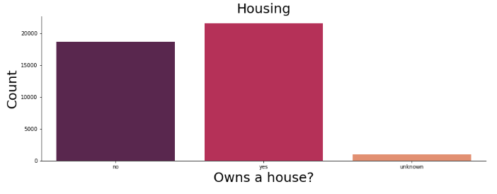

Slide 21
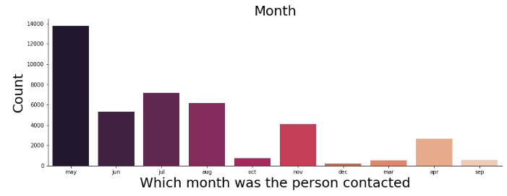
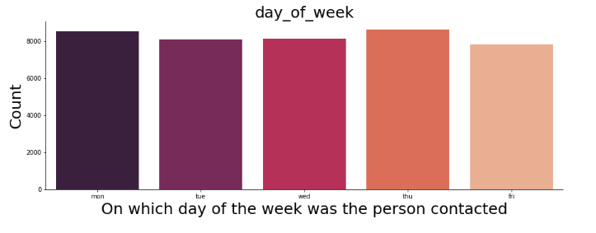
Plots showing which
Day and Month recorded
A surge in Numbers

Slide 22
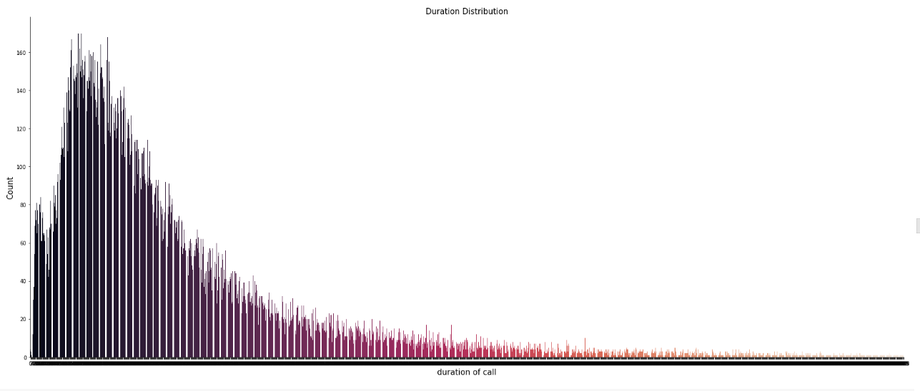
Distribution of Call Duration
We Can see with this Distribution that the Call Duration
Data is Right Skewed and

Slide 23
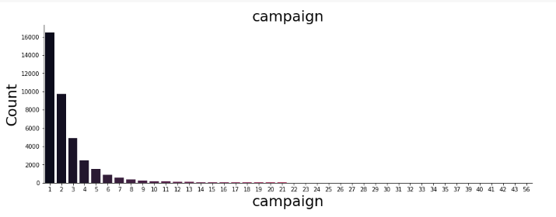
Campaign Data
We Can see that the Campaign data is also
Right Skewed and 1-3 campaigns consists of
70% of Total Campaign

Slide 24
What Processing Did We Perform
We Converted All Categorical Values into Numerical Variables by Encoding the Categorical Values with Label Encoders
We encoded the Output(Target) variable ‘y’ by mapping it into 0 and 1 as it is a Binary Classification Problem
We binned some Float Variables by using Intervals and removed outliers with IQR Formula (1.5 * IQR)
We Grouped Some Values by filtering them within a Range and Assigning them a Value

Slide 25
2. Model Training
Here the First thing we did was to Segment the Data as Independent Variables and Dependent Variables
Independent Variables (X train and test):
data - ['age', 'job', 'marital', 'education', 'default', 'housing', 'loan', 'contact', 'month', 'day_of_week', 'duration', 'campaign', 'pdays', 'previous', 'poutcome', 'emp.var.rate', 'cons.price.idx', 'cons.conf.idx', 'euribor3m', 'nr.employed']
Dependent Variables (y train and test):
data - [y]

Slide 26
2.1) Splitting the Data
We Used Train Test Split to Split the Data as training set and test Set
The Threshold for Splitting the Data is 25%
Therefore, The Total Training Set for X_train is 26287 Rows, 20 Columns and
Total Training Set for y_train is 26287 Rows and Total Test Set for X_test is 8763 Rows, 20 Columns and Total Test Set for y_test is 8763 Rows.

Slide 27
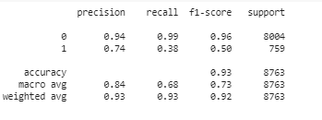
Algorithm – 1: SVC
We used Support Vector Classifier and Performed Scaling to Scale the Independent Variables.
We got an Accuracy of 93%
The Classification Report is Given Below

Slide 28
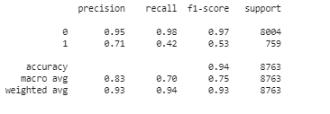
Algorithm – 1: SVC
We now performed Hyper parameter Tuning with Grid Search CV and fixed parameters (parameter grid, kernel etc) so that the model adapts itself and fits the best suited Hyper parameter.
The Model performed well and there was a great improvement in Our Precision, Recall and F1 Score

Slide 29
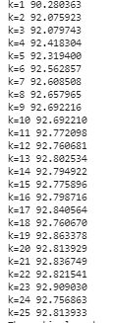
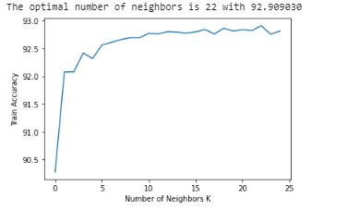
Algorithm – 2: KNN
We used K Nearest Neighbor Algorithm with K fold Cross Validation with k as 25, and we got optimum neighbors as 22.
The Model provided 92% Accuracy

Slide 30
Algorithm – 3: Decision Tree
Here We, tried with Decision Tree Classifier and got good Results. We didn’t Tune Hyper Parameters, and Trained/Tested the Model with 90% Accuracy
We then exported the model to graphviz for visualization
This Model had a Recall Score of 88% and ROC/AUC Score of 85%
We used Decision tree to check the Feature Importance of the Model by identifying their Relative Importances

Slide 31
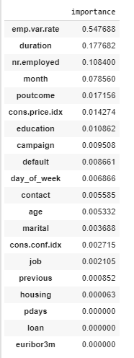
Model Importance
The Importance Score given helps us in Identifying which Features are of Much importance to the Model and it is Sorted in Ascending Order (High Importance to Low Importance)

Slide 32
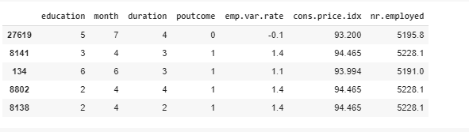
3. Dataset Selection and proceeding
We Take only the Top Important Feature and train the Model to give better Output.
This Model Consists of “Education, Month, Duration, Poutcome, Emp.var.rate, Cons.price.index and nr.Employed

Slide 33
Training and Testing new model
We Use Decision Tree Classifier to Train and Test the Machine Learning Model and We got the Metrics Results as:
The Accuracy is 81.54741526874358
The Recall Score is 88.66930171277997
The ROC/AUC Score is 84.77068284039798

Slide 34
Large Ensemble ML Algorithms
Here, We tried building the Model with Multiple Algorithms such as,
Stochaistic Gradient Descent
Random Forest with Gridsearch CV
Logistic Regression
K Nearest Neighbors
Gaussian Naïve Bayes
Perceptron
Linear Support Vector Classifier
Decision Tree Classifier

Slide 35
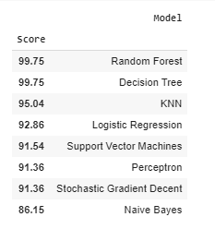
Model Results
The Models Performed Extensively well with Random Forest (Ensemble Model) and Decision Tree Classifier. It Performed Poorly on Gaussian Naïve Bayes

Slide 36
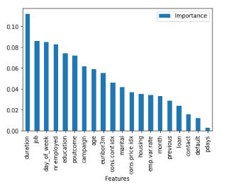
Feature Importance
The Feature Importance from the Random Forest Model is Plotted Here
The Statistical Results from the Model are
Mean Score – 92% Accuracy
Standard Deviation – 3% Deviation
Scores :
[0.92544694 0.92925067 0.92468619 0.93647775 0.93001141 0.93077216 0.92582731 0.92998478 0.93150685 0.93226788]

Slide 37
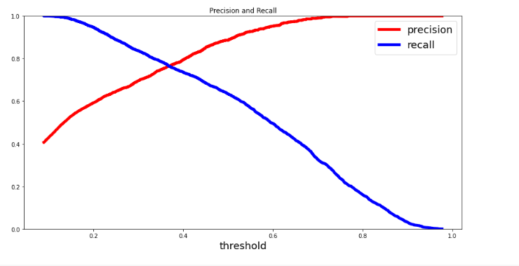
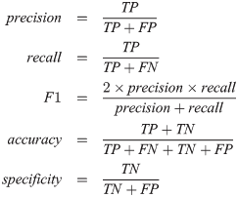
Precision and Recall Curve for the Model

Slide 38
Remarks
We would advise the Marketing team to Target on Age Groups with 25 – 55 years as it comprises of Larger Set of Audience
The Important Features to Identify in Subscribing to Term Deposits are stated below:
  Duration, Job Type, Day of week, Nr.Employed, education, Poutcome, Campaign, age, euribor3m etc.
  These Influences the Model to a greater extent, So the Data Capturing and overlooking on these attributes are a Must.

Slide 39
Thank You
Web URLS:
https://www.linkedin.com/in/ravishankar-ramakrishnan-155848126/
https://github.com/ravishankarramakrishnan/
https://myportfolioravi.wordpress.com/2018/05/07/my-resume/
Ravishankar ramakrishnan
Email: mailtoravi7895@gmail.com
Phone: 7010974018

